Slide 1
Additive Manufacturing in Aerospace
Team 508:
David Jay Michael Nalovic Sofia Rodriguez Tristan Wahl
Notes:
Don’t assume what is already done, further explain

Slide 2
Additive Manufacturing in Aerospace
Team 508:
David Jay Michael Nalovic Sofia Rodriguez Tristan Wahl

Slide 3
Meet Team 508
David Jay
Manufacturing Engineer
Michael Nalovic
Controls Engineer
Sofia Rodriguez
Aeronautics Engineer
Tristan Wahl
Design Engineer
Tristan Wahl

Slide 4
Sponsors and Advisor
Florida Space Grant Consortium
Dr. Yousuf Ali
Teaching Faculty II
Seminole
RC Club
Tristan Wahl

Slide 5
Project Objective
Design and manufacture an airplane capable of competing in the SAE Aero Design Competition.
Tristan Wahl
Notes:
Try to stop

Slide 6
Sponsor Needs
01
02
03
AHERE TO SAE
GUIDELINES
INNOVATION
3D PRINTED
PLANE
Follow SAE competition rules and restrictions
Create a new and different design
Majority of the plane must be made of 3D printed material
Tristan Wahl
Notes:
Our primary customer for this project is our Senior Design Professor, Dr. McConomy. He gave us 3 primary needs:
-of course we need to comply with SAE competition guidelines
-We need to be innovative in some way or another. Incorporating new ideas wherever possible
-Finally, Dr. McConomy has specified that our plane must be 3D printed. This means that the majority of structural components must be 3D printed.

Slide 7
Sponsor Needs
01
02
03
AHERE TO SAE
GUIDELINES
INNOVATION
3D PRINTED
PLANE
Follow SAE competition rules and restrictions
Create a new and different design
Majority of the plane must be made of 3D printed material
Tristan Wahl
Notes:
Our primary customer for this project is our Senior Design Professor, Dr. McConomy. He gave us 3 primary needs:
-of course we need to comply with SAE competition guidelines
-We need to be innovative in some way or another. Incorporating new ideas wherever possible
-Finally, Dr. McConomy has specified that our plane must be 3D printed. This means that the majority of structural components must be 3D printed.

Slide 8
Sponsor Needs
02
01
03
INNOVATION
AHERE TO SAE
GUIDELINES
3D PRINTED
PLANE
Create a new and different design
Follow SAE competition rules and restrictions
Majority of the plane must be made of 3D printed material
Tristan Wahl
Notes:
Our primary customer for this project is our Senior Design Professor, Dr. McConomy. He gave us 3 primary needs:
-of course we need to comply with SAE competition guidelines
-We need to be innovative in some way or another. Incorporating new ideas wherever possible
-Finally, Dr. McConomy has specified that our plane must be 3D printed. This means that the majority of structural components must be 3D printed.

Slide 9
Sponsor Needs
03
01
02
3D PRINTED
PLANE
AHERE TO SAE
GUIDELINES
INNOVATION
Majority of the plane must be made of 3D printed material
Follow SAE competition rules and restrictions
Create a new and different design
Tristan Wahl
Notes:
Our primary customer for this project is our Senior Design Professor, Dr. McConomy. He gave us 3 primary needs:
-of course we need to comply with SAE competition guidelines
-We need to be innovative in some way or another. Incorporating new ideas wherever possible
-Finally, Dr. McConomy has specified that our plane must be 3D printed. This means that the majority of structural components must be 3D printed.

Slide 10
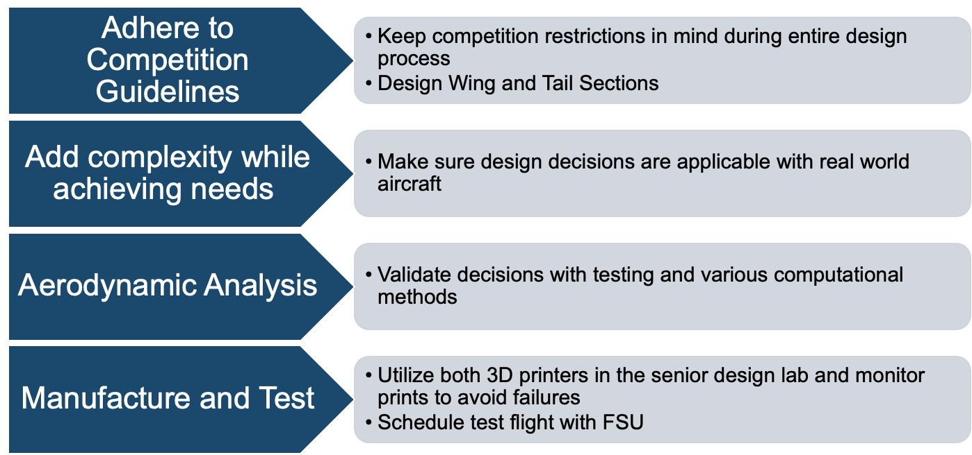
Key Goals
Tristan Wahl

Slide 11
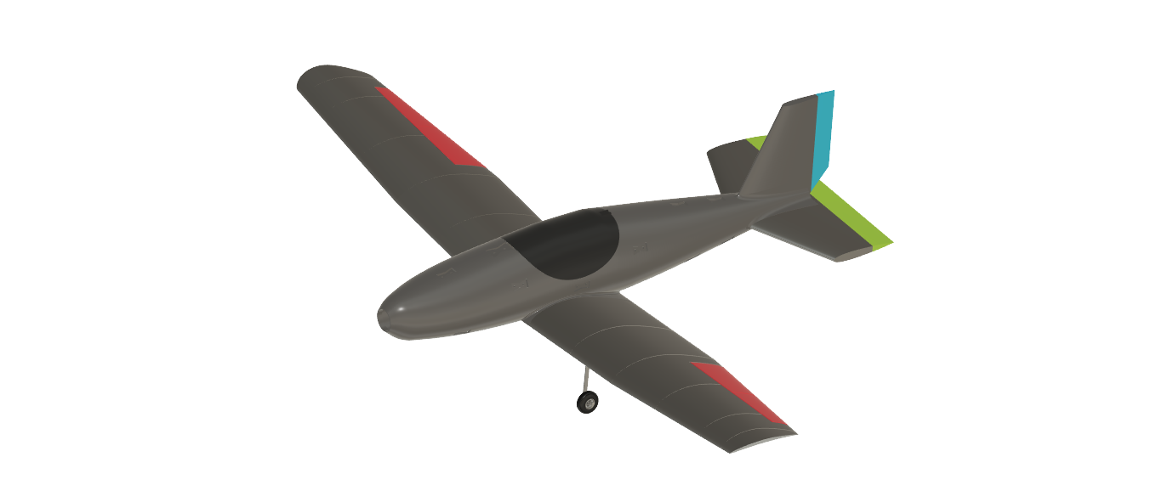
Airplane Controls
1
Ailerons – Control Roll
2
Elevator – Controls Pitch
3
Throttle – Controls Motor Thrust
4
Rudder – Controls Yaw
Tristan Wahl
Notes:
Change this to our plane
RC aircraft generally have at least the first 4, HOWEVER, some configurations can get away with only 3.

Slide 12
Major Functions
Takeoff
Landing
Carry Payload
Flight Controls
Michael Nalovic
Notes:
Animate this to go in a specific order
And correct the alignment

Slide 13
Targets and Metrics
Takeoff
Flight Control
Metric
Metric
Metric
Takeoff Distance
Thrust Force
Wing Area
Metric
Metric
Metric
Control Surface Deflection
Rise Time of Motor Speed
Static Margin
Less than 100ft
Greater than 10lbs
Greater than 6 ft
At least 25°
4 seconds
5%– 15%
Target
Target
Target
Target
Target
Target
2
Michael Nalovic
Notes:
Our team allowed the fuselage group to determine their own targets and metrics for the payload and landing gear, while we focused more on takeoff and controlling the plane. Here we have displayed some of the most important metrics that contribute to the aerodynamic success of the airplane.
Our takeoff distance was predefined by the competition guidelines. Using this metric, we made some initial estimates to calculated a required thrust force for the plane based on a wing with a 6ft^2 planform area. The only reason a minimum planform area is defined as a metric is because our calculations all began with that minimum assumption.
For control, the first metric we placed was a minimum control surface deflection. Typically control surfaces lose effectiveness past 20deg, so we design for a larger deflection that can be turned down on the transmitter. In addition, we also require that the motor selected has a minimum rise time of 4 seconds. This will ensure that the pilot has ample throttle control to get out of potentially dangerous situations. Finally, we have set a target for the static margin of the airplane. The static margin is an indicator of the airplanes pitch stability and should be between 5% and 15%

Slide 14
Targets and Metrics
Carry Payload
Landing
Metric
Metric
Metric
Securing
Load/Unload
Geometrical Shell
Metric
Metric
Metric
Mechanical Taxi
Landing Distance
Shock Absorption
Motion Prevented
Under 1 Minute
Fully Encapsulated
Rudderless Control
Less than 400 feet
Intact Fuselage
Target
Target
Target
Target
Target
Target
Michael Nalovic
Notes:
Our team allowed the fuselage group to determine their own targets and metrics for the payload and landing gear, while we focused more on takeoff and controlling the plane. Here we have displayed some of the most important metrics that contribute to the aerodynamic success of the airplane.
Our takeoff distance was predefined by the competition guidelines. Using this metric, we made some initial estimates to calculated a required thrust force for the plane based on a wing with a 6ft^2 planform area. The only reason a minimum planform area is defined as a metric is because our calculations all began with that minimum assumption.
For control, the first metric we placed was a minimum control surface deflection. Typically control surfaces lose effectiveness past 20deg, so we design for a larger deflection that can be turned down on the transmitter. In addition, we also require that the motor selected has a minimum rise time of 4 seconds. This will ensure that the pilot has ample throttle control to get out of potentially dangerous situations. Finally, we have set a target for the static margin of the airplane. The static margin is an indicator of the airplanes pitch stability and should be between 5% and 15%

Slide 15
Analytical Validation
Servicing and Repair
Fitment
Full System Integration
Control Surface Actuation
Finish
Adhesion Effectiveness
Weight
Meets Target Metric
Stable Static Margin
Michael Nalovic
Notes:
Static margin
Moving of soccer ball

Slide 16
Reusability
Flight
Stability During Climb
Maneuverability for Flight Pattern
Landing
Durability During Impact
Responsiveness of Control Surfaces
Shock Distribution
Take Off
Mechanical Taxi
Propellor Clearance
High Lift
Flight Validation
Michael Nalovic
Notes:
Static margin
Moving of soccer ball

Slide 17
Material Selection
Lightweight PLA
Uses active foaming technology
PLA + blowing agent the filament produces gasses when heated to 230 degrees Celsius
Reduces the weight of printed parts up to 65% compared to regular PLA
David Jay
Notes:
big portion of our project is 3D printing since our sponsor required that 90% of our project be made of 3D printed material

Slide 18
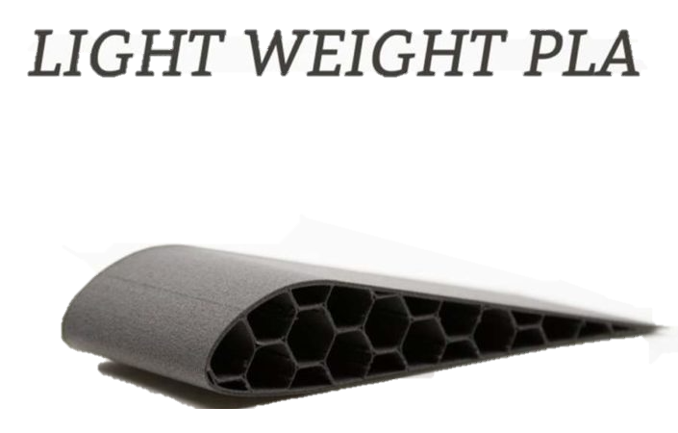
Material Selection
our options
David Jay
Notes:
What Our options are

Slide 19
Infill
Infill is the structure inside the piece that holds the model together
It is used to give strength to the printed model with the minimal use of material
It can be printed in varying degrees of hollowness known as infill density
David Jay
Notes:
What

Slide 20
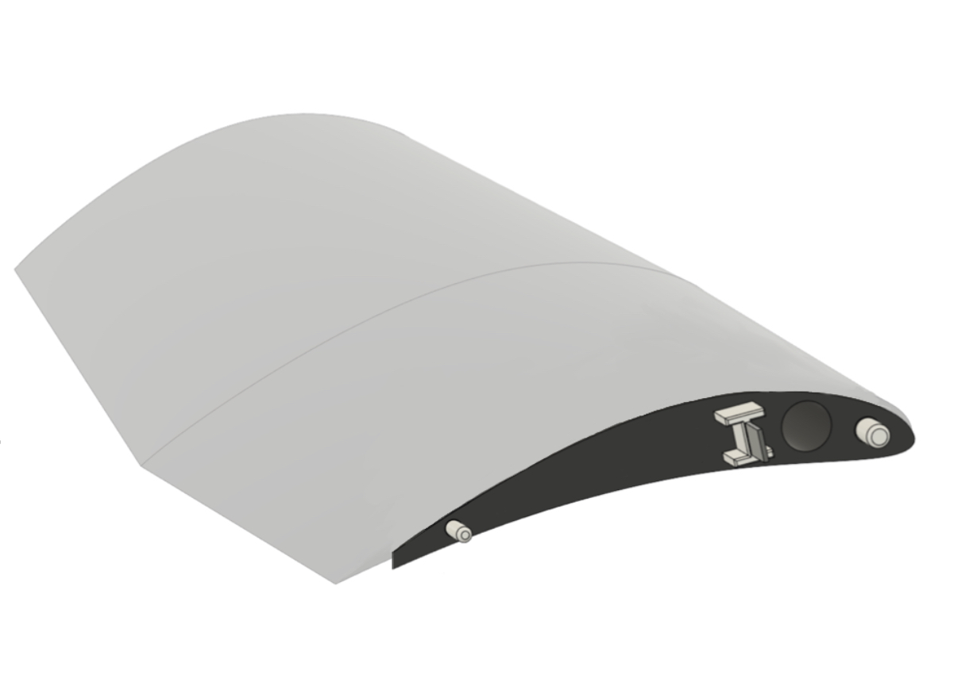
Light Weighting
David Jay
Notes:
Grow left one to emphasize cross section and do the same with the right one
4 step animation

Slide 21
Weight Estimation
$${\text{ρ}}_{Initial}=2.1\frac{g}{{cm}^{3}}$$
$${\text{ρ}}_{Shell}=flowrate∗{\text{ρ}}_{Initial}$$
$${\text{V}}_{Shell}=SA∗thickness$$
$${\text{ρ}}_{infill}=infill\%∗{\text{ρ}}_{Shell}$$
$$V_{infill}=V−V_{shell}$$
David Jay

Slide 22
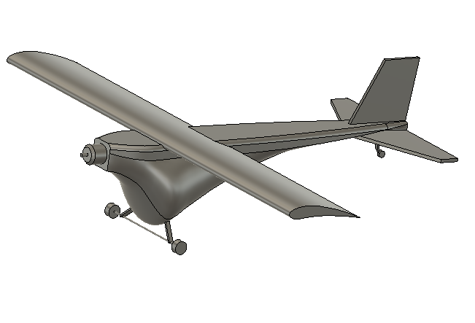
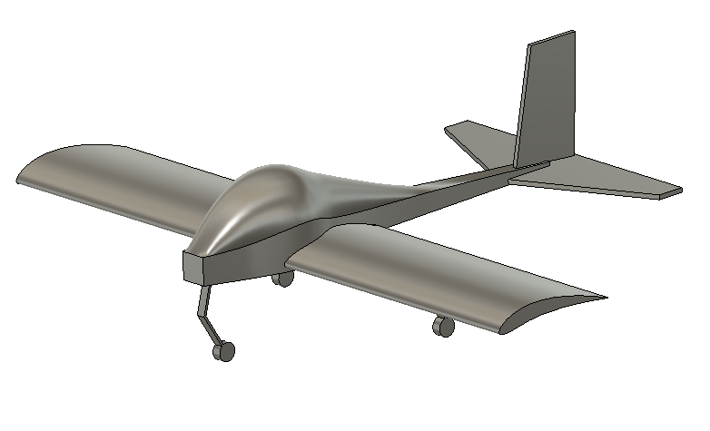
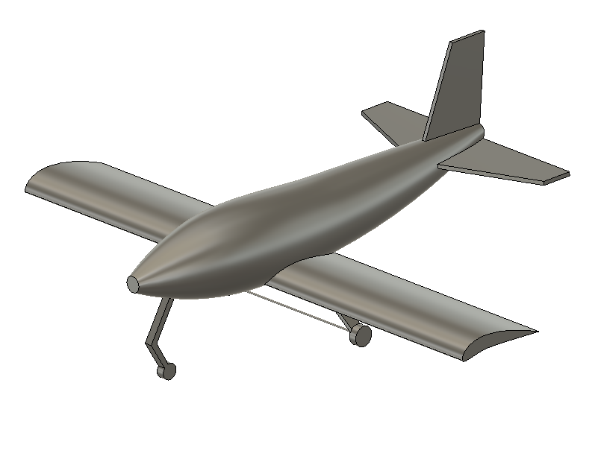
Concepts
Guppy
Dolphin
Whale
Sofia Rodriguez

Slide 23
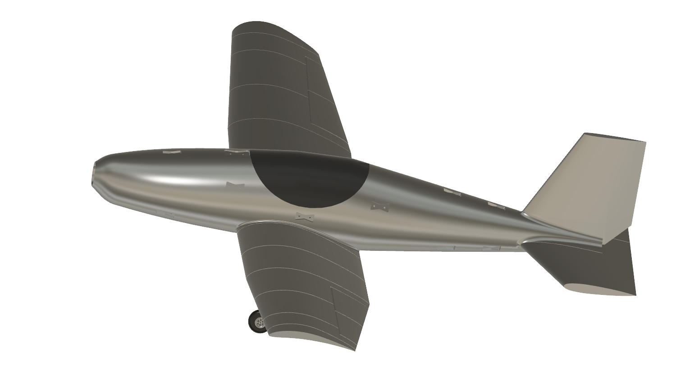
Whale Fuselage Design
Sofia Rodriguez

Slide 24
Wing Design
Eppler 423 Airfoil
Low Wing
Hoerner Wing Tips
Tapered Wings
Sofia Rodriguez

Slide 25
Tail Design
Conventional Tail
Cross Connection to Fuselage
Tail Dragger Landing Gear
Sofia Rodriguez

Slide 26
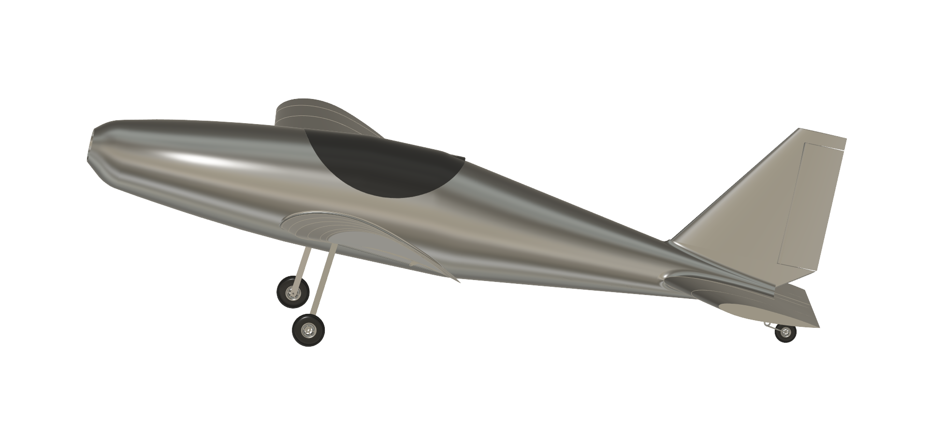
Static Margin
Static margin is used to determine stability of the plane
Calculated from Center of Gravity to the neutral point
Ideal static margin would be between 5-15%
Sofia Rodriguez
Notes:
Change the view to be side vide no tilt
Tilt one way

Slide 27
Wings
Eppler 423 Airfoil
High lift coefficient due to the highly cambered profile
Designed for lower speeds
Smoother small due to the high lift coefficient
Sofia Rodriguez
Airfoil selection: explain what is important
Sections separated
Should what the taper ratio indicates
Dihedral
Wingtips

Slide 28
Wings
Hoerner Wing Tips
Effective wingspan increases without increasing the geometric wingspan, therefore decreasing drag
Reduces distance required for take-off
Increases overall stability
Sofia Rodriguez
Airfoil selection: explain what is important
Sections separated
Should what the taper ratio indicates
Dihedral
Wingtips
Notes:
https://www.myplane.nl/cherrydocs/THEORETICAL_ASPECTS_AND_PRACTICAL_US_AGE.pdf

Slide 29
Wings
Dihedral
Upward angle of aircraft’s wing, increases stability by causing the lower wing to fly at higher angle of attack compared to a high wing
5° Angle the wing makes with the horizonal
Provides the plane with roll stability
Sofia Rodriguez
Notes:
https://www.myplane.nl/cherrydocs/THEORETICAL_ASPECTS_AND_PRACTICAL_US_AGE.pdf
Taper and measurement

Slide 30
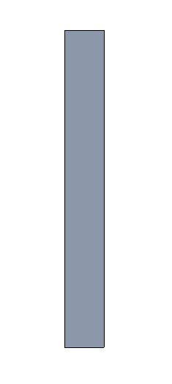
Spar Selection and Connection
Aluminum 6061
Lightweight
High Strength Characteristics
Higher Strength than circular spar
Spars will be connected by a bracket within the fuselage
$$Side: \frac{3}{4}in$$
6 $in$
$$\frac{3}{32}in$$
36 $in$
Sofia Rodriguez
Notes:
Explain why we made these decisions
From where
Why

Slide 31
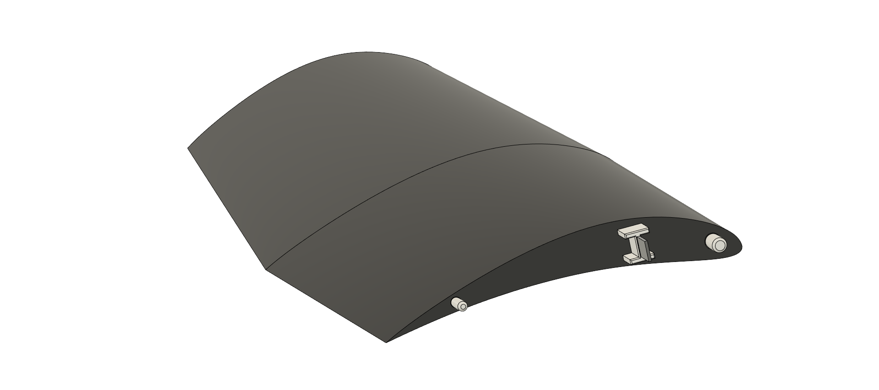
Assembly Method
I-Beams were selected to hold the spars
Reduce and resist shear stress
Flanges act to prevent any bending or vibration that could occur during flight
Web securely hold the spars
Sofia Rodriguez
Notes:
Show I beam bending, vibrating
Vibration – certain mass and stiffness selected to prevent vibrations
Bend – strength of I beam should accommodate yield stress
Buckling – flanges chosen to prevent buckling locally, sideways, or torsionally
Tension – web thickness that wont fail, buckle ,or ripple
Take out circle

Slide 32
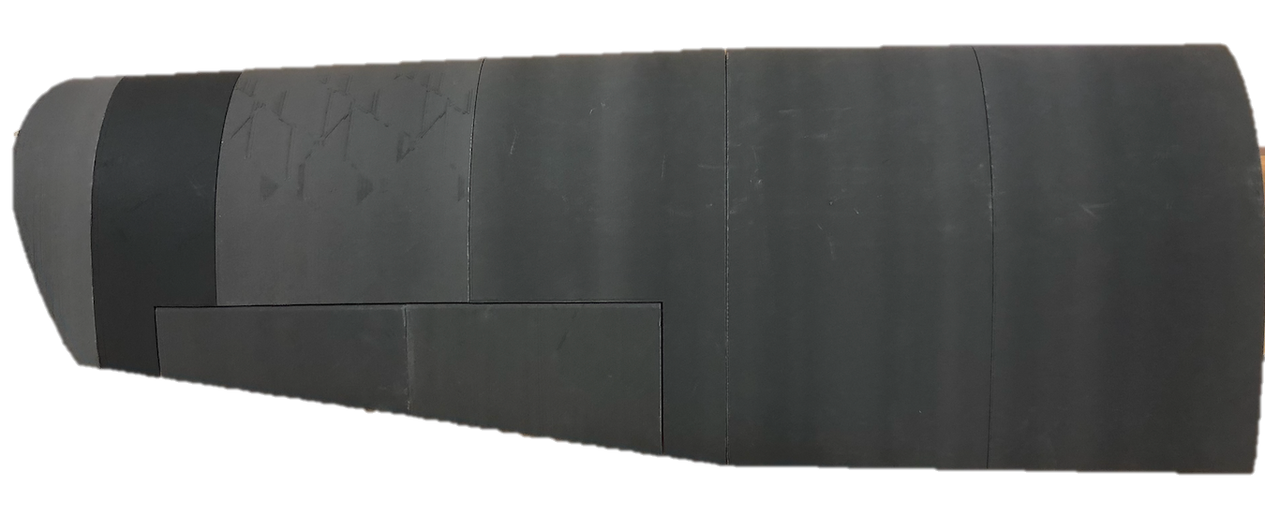
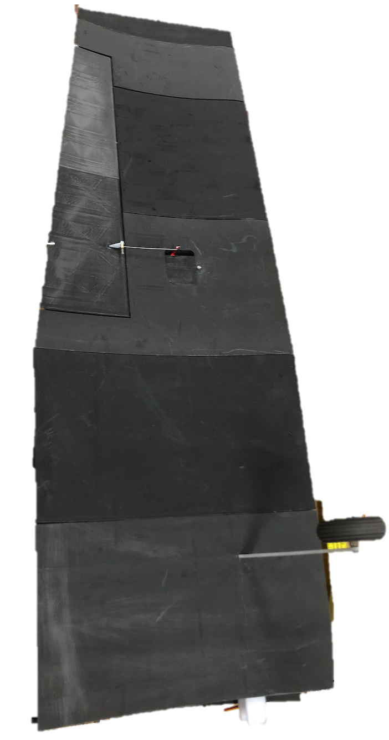
Manufacturing Wings
Landing Gear
Figure 1: Top View of Wing
Aileron
Control Surface
Servo
Housing
and
Linkage
Figure 2: Bottom View
Sofia Rodriguez
Notes:
Include view of airfoil

Slide 33
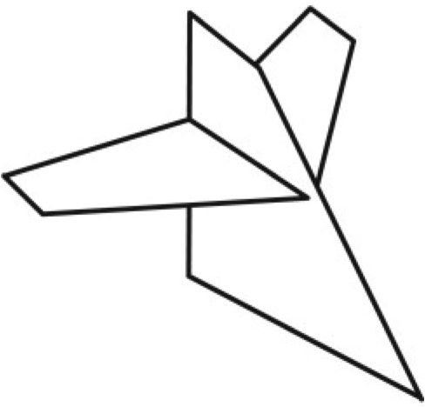
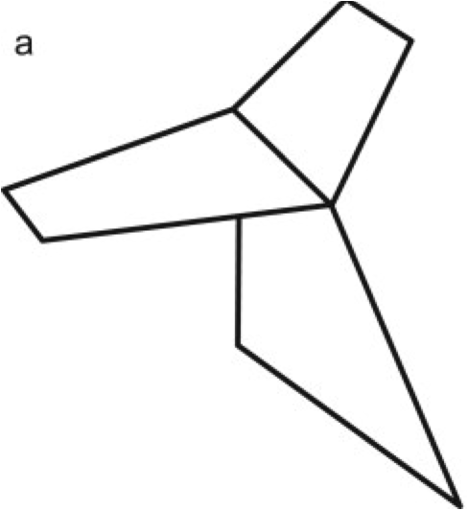
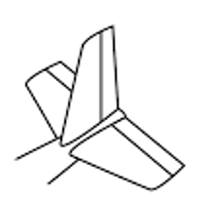
Tail
Primary job of tail is to add stability to aircraft
Compared with a T-tail and cruciform, the conventional tail was the simplest solution for achieving both structural and aerodynamic needs
Knowing the span and planform area of the main wing, the areas of both vertical and horizontal sections could be calculated
Figure 3: T-tail, Cruciform and conventional tail setups
Tristan Wahl

Slide 34
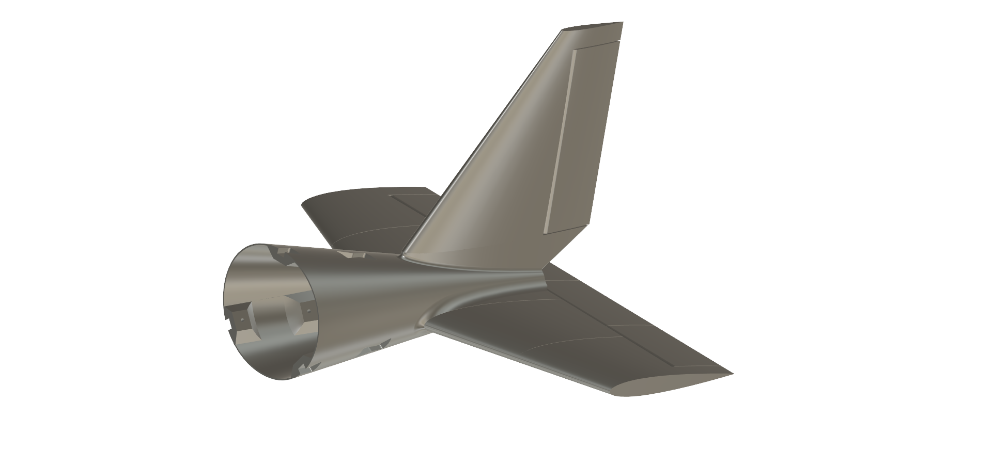
Aero Design of Tail
Airfoil: NACA 0012
Horizontal taper ratio: 0.50
Vertical taper ratio: 0.33
Horizontal area: 221.4 in²
Vertical area: 86.4 in²
20° of rudder and elevator actuation is ideal for low-speed aircraft
Figure 4: Tail Assembly
Tristan Wahl

Slide 35
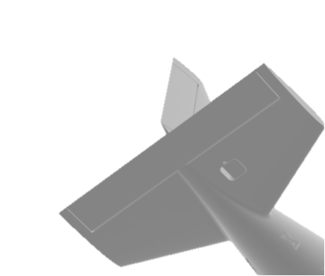
Horizontal Tail
Entire airfoil held under tension with aluminum spar running through front part of sections
Elevator will be held by 2" aluminum pins and actuated by servo on underside of airfoil
20° of actuation in both directions
Figure 5: Underside of Horizontal tail assembly
Tristan Wahl
Notes:
Add figure #s
Maybe split into two slides

Slide 36
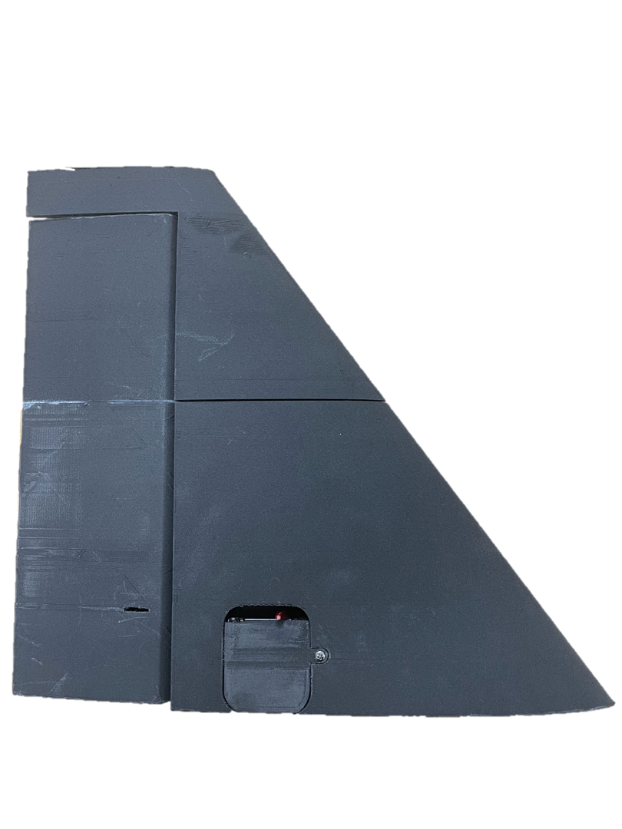
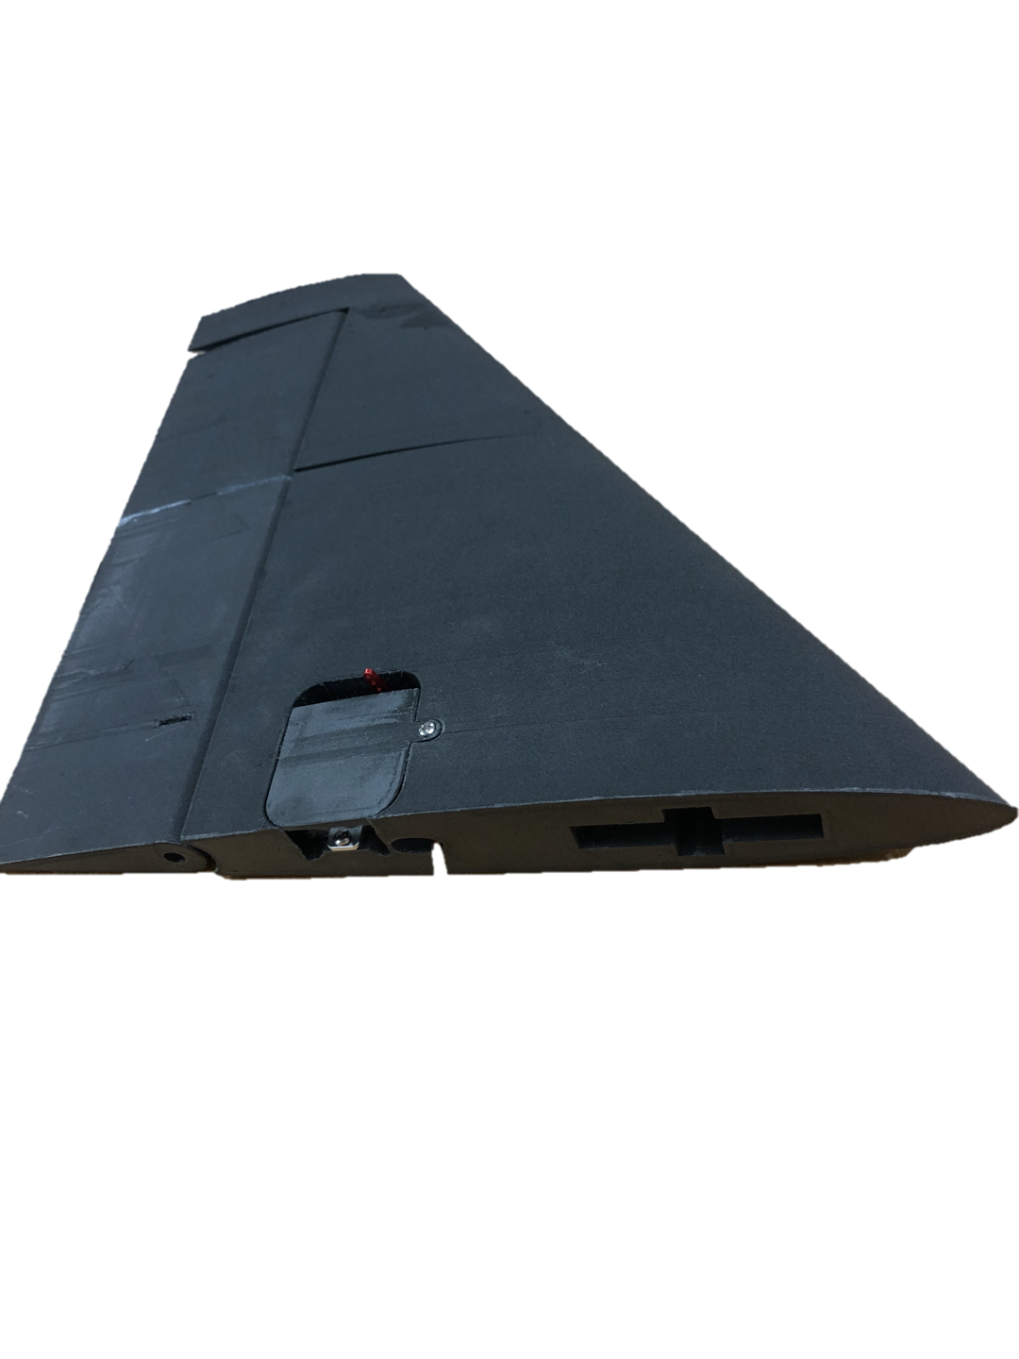
Vertical Tail
3D printed pins for rudder instead of aluminum
Connections to fuselage in front with cross style connection and in back with elliptical pin to allow for servo wiring
Figure 6: Vertical Tail Assembly
Figure 7: Bottom view of vertical assembly
Tristan Wahl
Notes:
Add figure #s
Maybe split into two slides

Slide 37
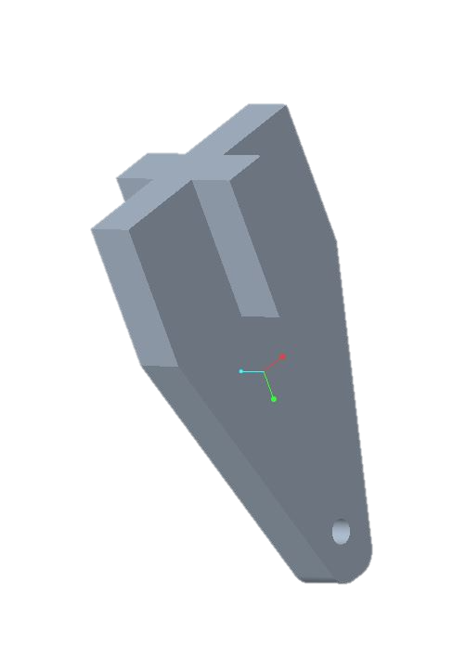
Tail Connections
1 $in$
$$\frac{1}{2}in$$
Connection to the main fuselage using the horizontal spar
Cross style connection to provide vertical and horizontal stability
$$\frac{1}{2}in$$
Figure 9: Detail of Top View
Figure 8: Vertical Connector
Tristan Wahl
Notes:
Figure #

Slide 38
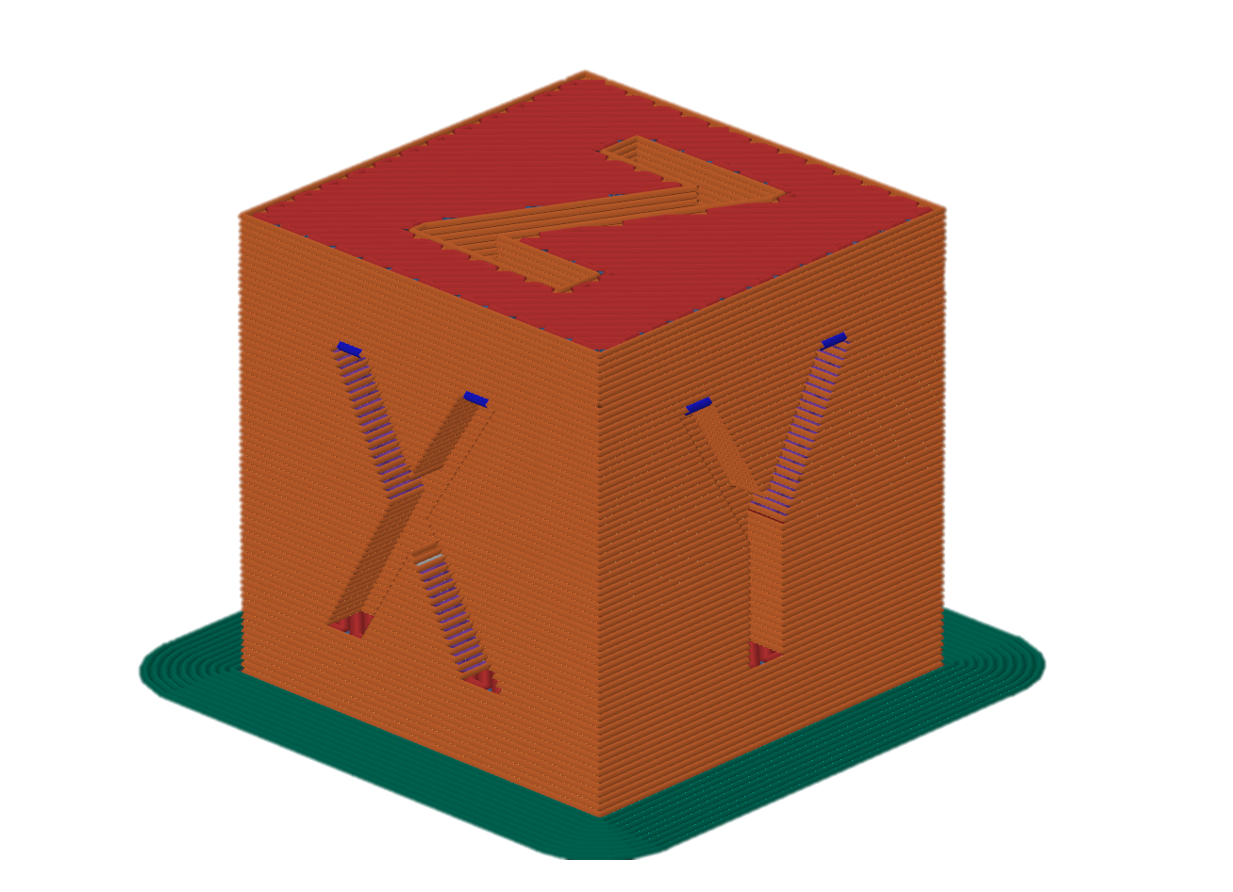
Manufacturing
CAD
SLICER
PRINTER
David Jay
Notes:
Although our concept selection process deemed the SR-22 best for our project, this design lacked in the major aspect of innovation. For the "Final" concept our team will be moving forward with, we decided to use the general layout of the SR-22 design with a new, more innovative fuselage that is better suited for our application.

Slide 39
Design for 3D Printing
Design for 3D printing begins in the CAD software
Designers need to consider:
Size limitations
Print orientation
Minimizing overhangs and bridges
Tolerances
Raster Orientation
CAD
David Jay
Notes:
Make gears rotate and have plane appear

Slide 40
Slicing the Part
Slicing software converts CAD models into G-code
G-code files control all aspects of the print from nozzle temperature to movement speeds
Users must tune a variety of slicer settings to get strong and accurate prints
SLICER
David Jay
Notes:
Although our concept selection process deemed the SR-22 best for our project, this design lacked in the major aspect of innovation. For the "Final" concept our team will be moving forward with, we decided to use the general layout of the SR-22 design with a new, more innovative fuselage that is better suited for our application.

Slide 41
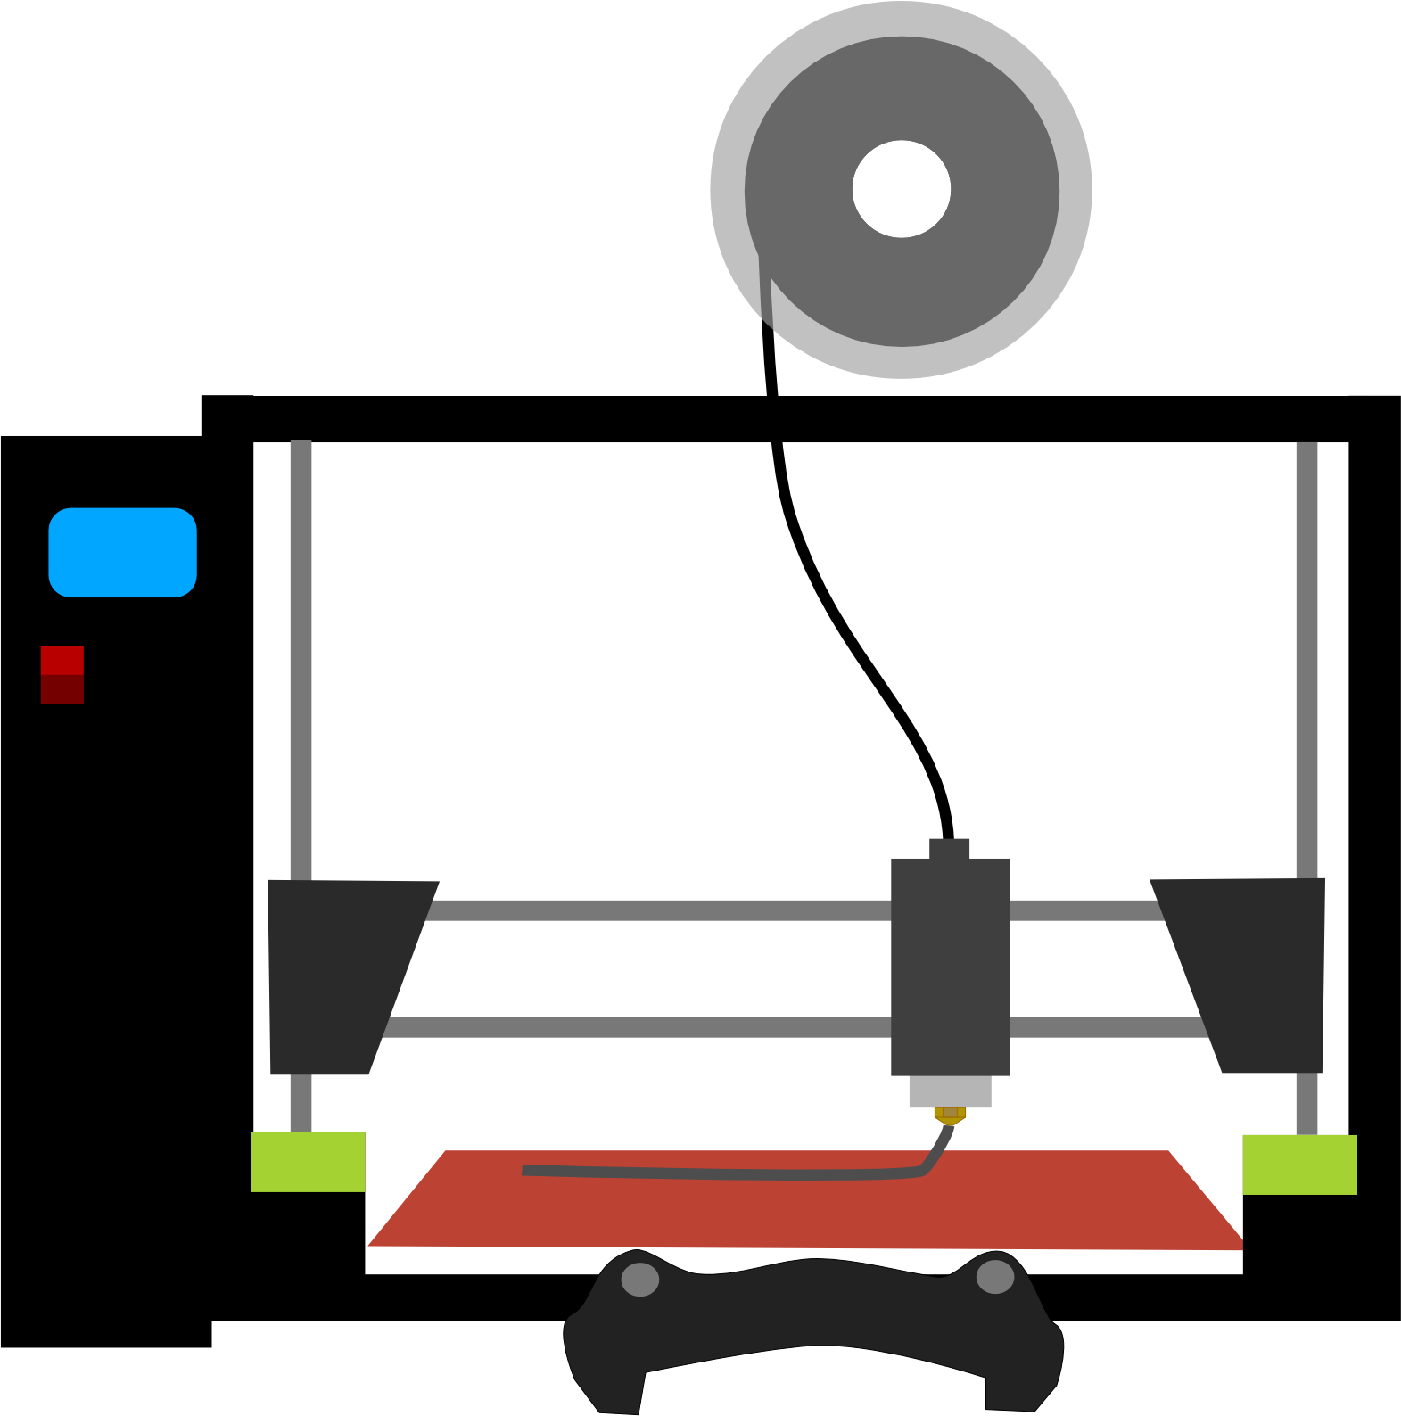
Printing
FDM 3D Printers Work by depositing melted plastic onto a build plate
It can take several hours for the plastic layers to build up into a full part
Failures occur frequently and in many different forms
Proper G-code slicing and regular printer maintenance help to ensure higher print success rates
PRINTER
David Jay
Notes:
Although our concept selection process deemed the SR-22 best for our project, this design lacked in the major aspect of innovation. For the "Final" concept our team will be moving forward with, we decided to use the general layout of the SR-22 design with a new, more innovative fuselage that is better suited for our application.

Slide 42
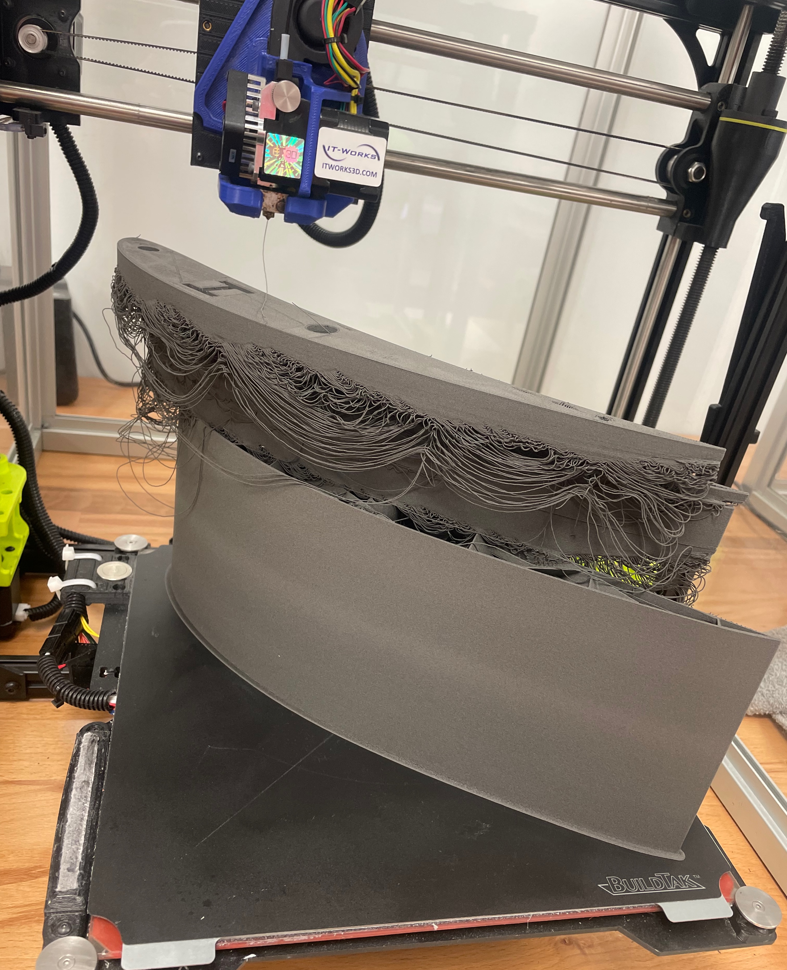
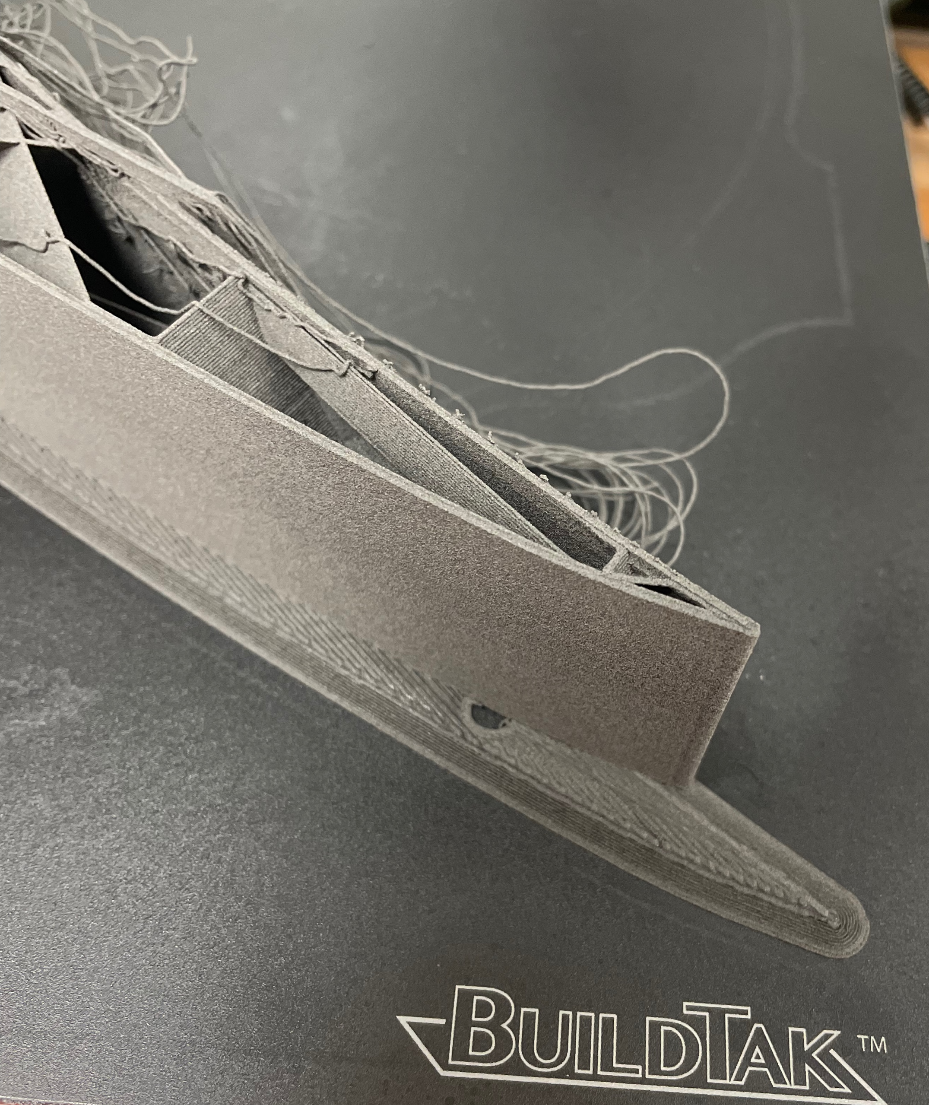
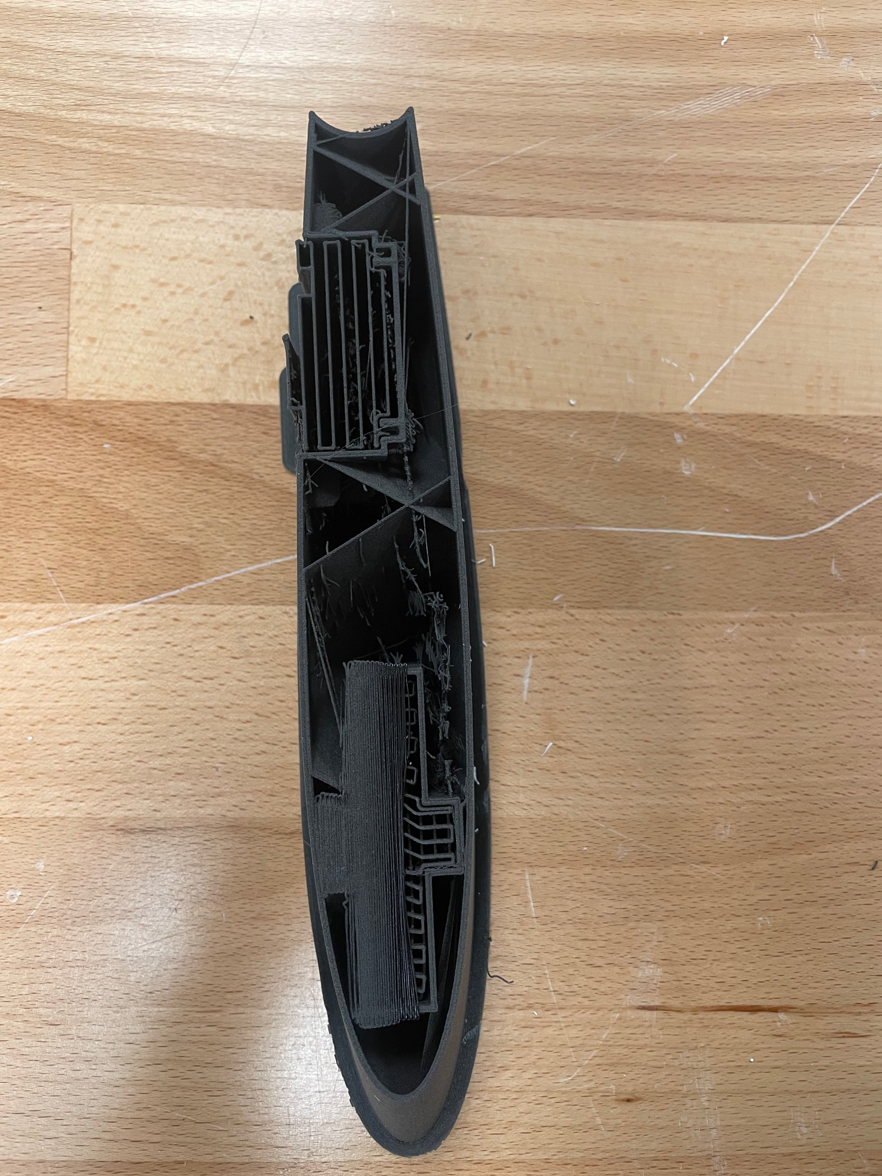
Manufacturing Trials
Figure 10: Side view of layer Shift
Figure 11: Top view of layer shift
Figure 12: Example of Thermal Runaway
David Jay

Slide 43
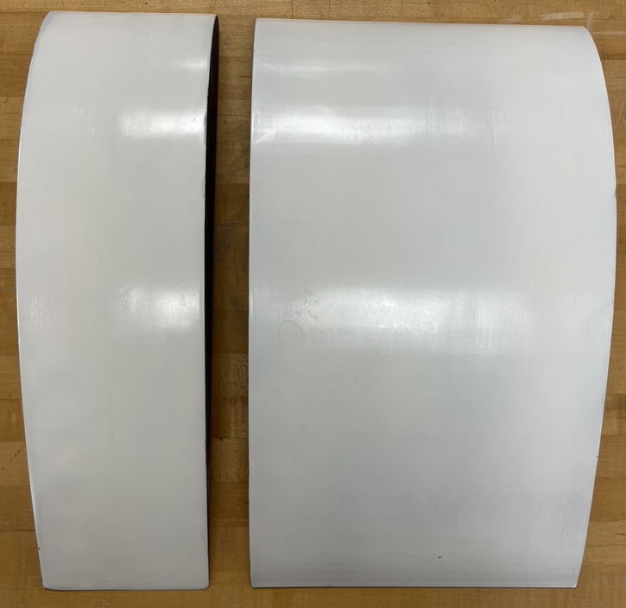
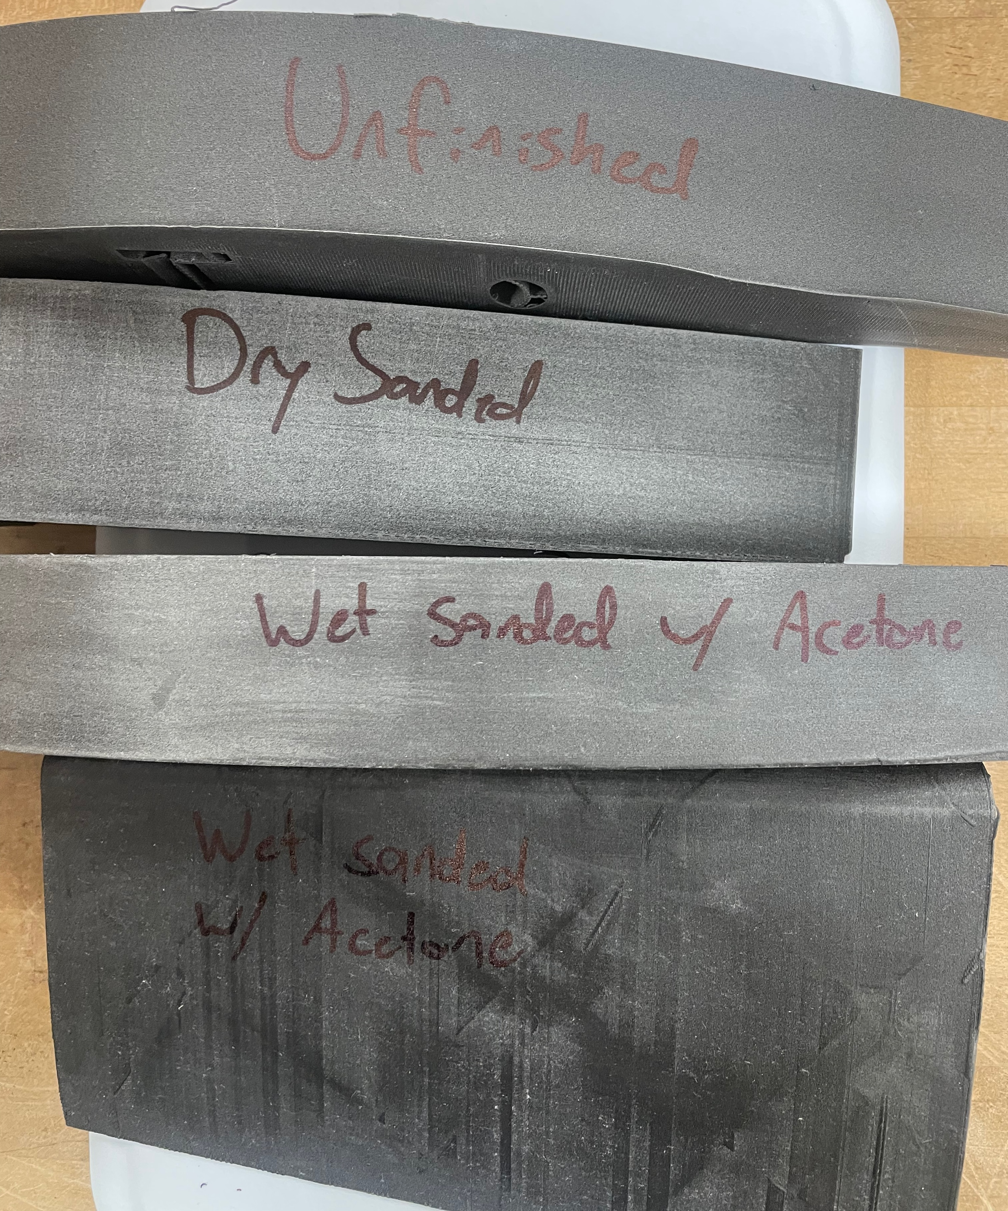
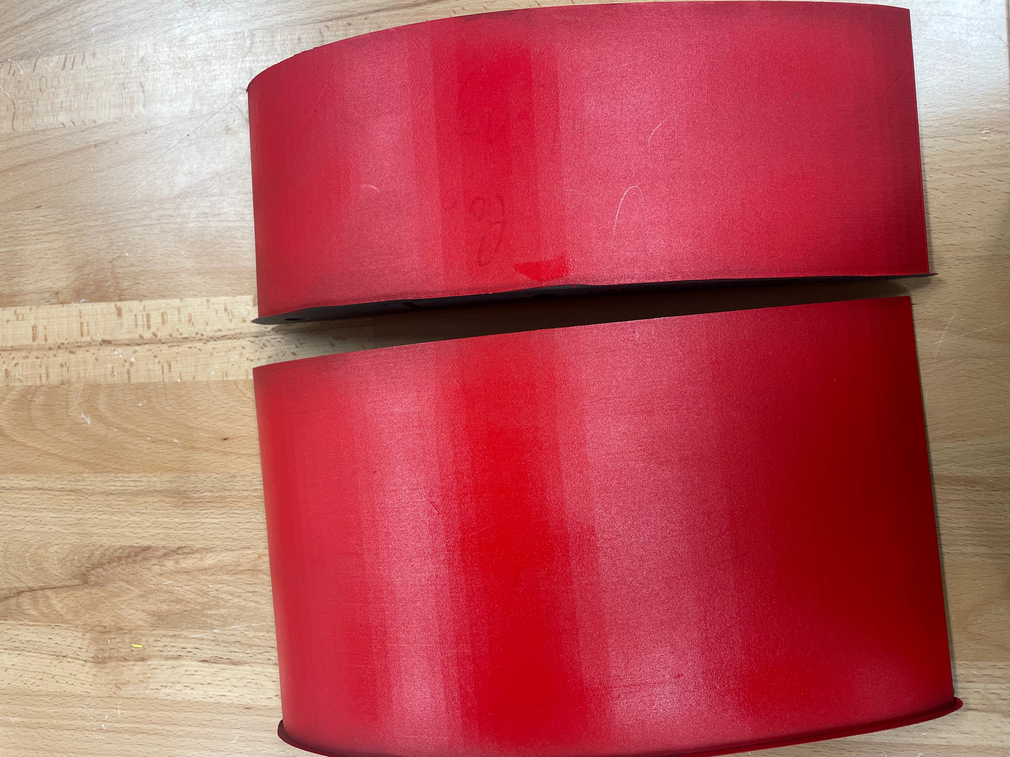
Finish Optimization
Figure 13: Various sanding methods
Figure 14: Spray paint finish
Figure 15: Painting with epoxy finish
Michael Nalovic
Notes:
Put graphics

Slide 44
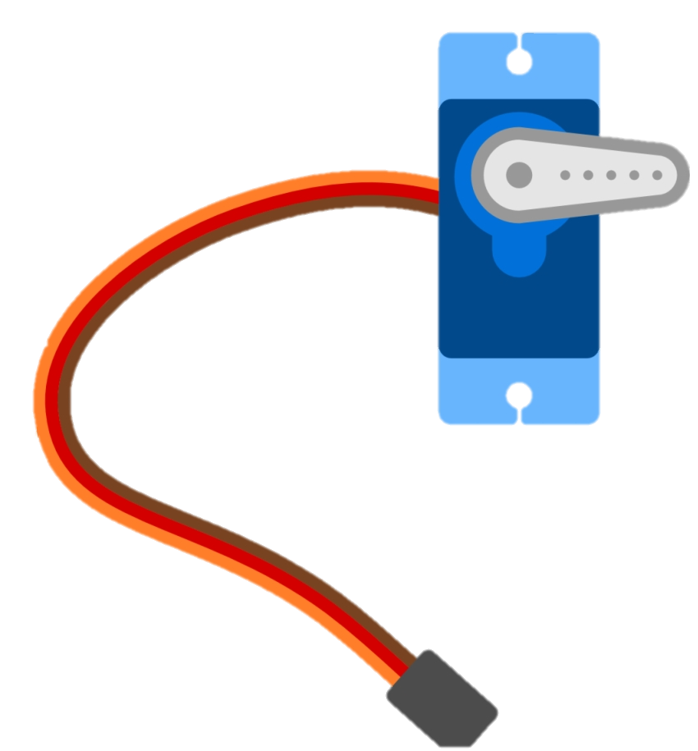
Controls
Servomotor Selection
Required Torque
Range of Motion
Fitment and Scale
Linkage Design
Four Bar analysis
Control Surface Integration
Weight Balance
Michael Nalovic

Slide 45
Thrust Test
Results for 2 Blade Propeller
Achieved approximately 9.5 lbs of thrust which correlates to about 42.3 Newtons
Required force for liftoff: 10 N
Michael Nalovic

Slide 46
Thrust Test
Results for 3 Blade Propeller
Achieved approximately 9.2 lbs of thrust which correlates to about 40.9 Newtons
Required force for liftoff: 10 N
Michael Nalovic

Slide 47
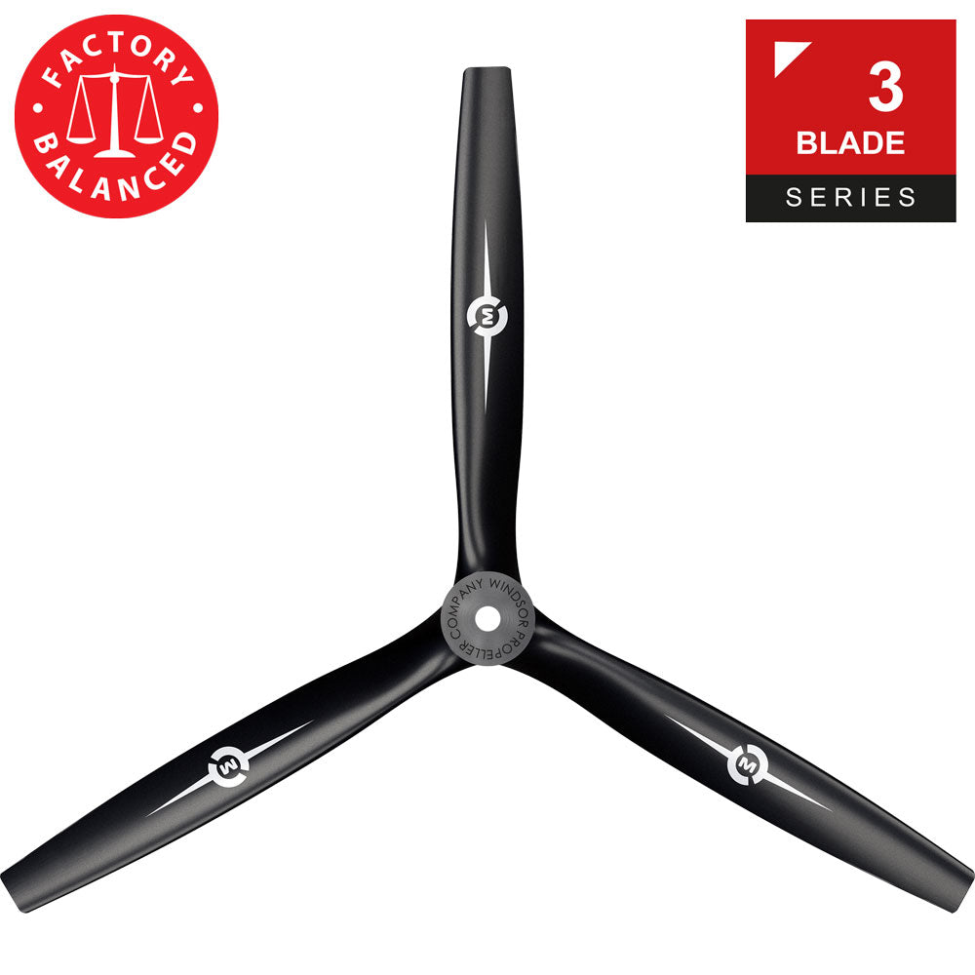
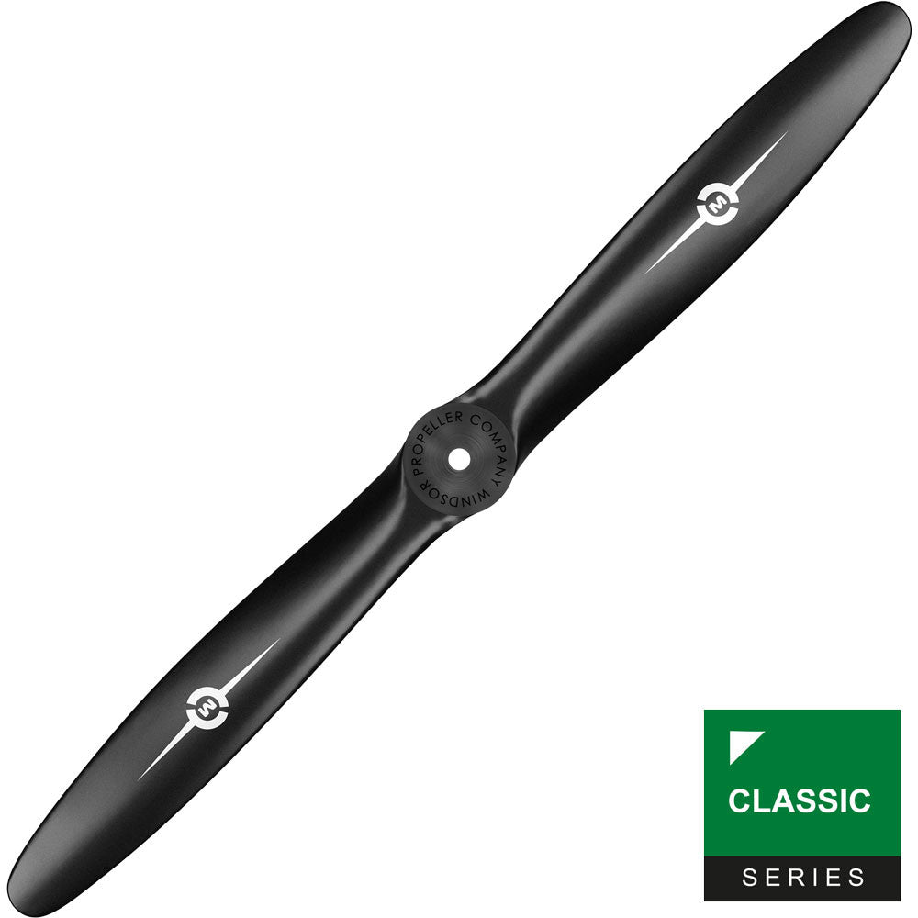
Comparison and Trade-offs
Primary Selection
Secondary Selection
Efficiency
Vibration
Clearance
Higher thrust to drag ratio for two blade
Less pulse per revolution for three blade
Similar thrust with extra clearance for three blade
Michael Nalovic

Slide 48
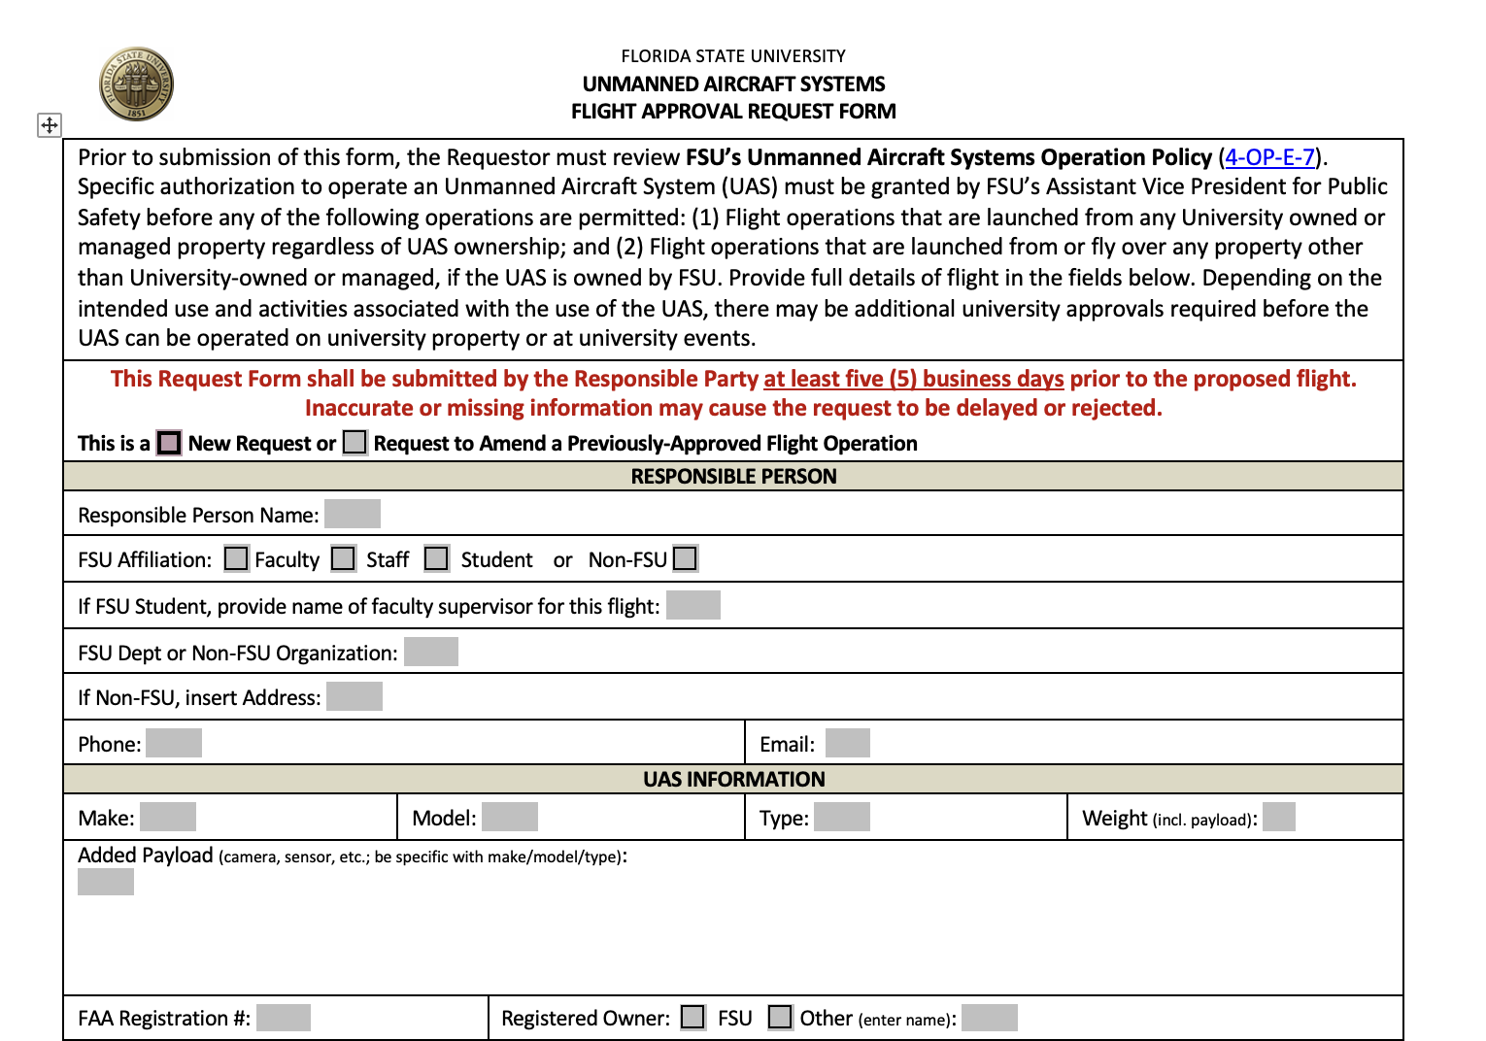
Test Flight
Location of Flight
Insurance Certificate
Weight of Plane
Pilot
Sofia Rodriguez
Notes:
Present or future?

Slide 49
Lessons Learned
01
02
03
FILE SHARING
PROJECT
METHODOLOGY
PROJECT
MANAGEMENT
Use a collaborative file sharing program
Improve the team’s methodology on deliverables
Improve the team’s organization by continuing the use of the task manager
Sofia Rodriguez
Notes:
Our primary customer for this project is our Senior Design Professor, Dr. McConomy. He gave us 3 primary needs:
-of course we need to comply with SAE competition guidelines
-We need to be innovative in some way or another. Incorporating new ideas wherever possible
-Finally, Dr. McConomy has specified that our plane must be 3D printed. This means that the majority of structural components must be 3D printed.

Slide 50
Incomplete Work
01
02
03
Submit Test Flight
Request
Final Assembly: Painting, Wiring,
and Gluing
Conduct Test Flight
Sofia Rodriguez

Slide 51
Summary
Begin Research and Concept Generation
Print
Prototypes
Select Final
Design
September
October
November
Finalize Goals and Functions
Finalize Airfoil, Taper, and Wingtips Design
Build Thrust Test
Sofia Rodriguez
Notes:
Should this be included?

Slide 52
Summary
Submit Purchase Requests
Finalize Tail
Design
Size
Control Surfaces
December
January
February
Integration between
Team 507 and 508
Begin Tolerance Testing and Wing Printing
Finish Wing Assembly
Sofia Rodriguez
Notes:
Should this be included?

Slide 53
Summary
Finalize Tail
Attachment
Buy
Wing Spars
Final
Assembly
February
March
April 7, 2022
Begin
Printing
the Tail
Finish Tail
and
Begin Wiring
Test Flight
Sofia Rodriguez
Notes:
Should this be included?

Slide 54
References
Dr. McConomy, S. (2021). Customer Needs.
“2022 SAE Aero Design Rules.” SAE Aero Design, www.saeaerodesign.com/cdsweb/gen/DocumentResources.aspx.
Raymer, D. P. (1992). Aircraft design: A conceptual approach.
Hermann, Stefan. “Colorfabb LW-Pla - Testing Foaming Pla.” CNC Kitchen, CNC Kitchen, 15 Feb. 2020, https://www.cnckitchen.com/blog/colorfabb-lw-pla-testing-foaming-pla.

Slide 55
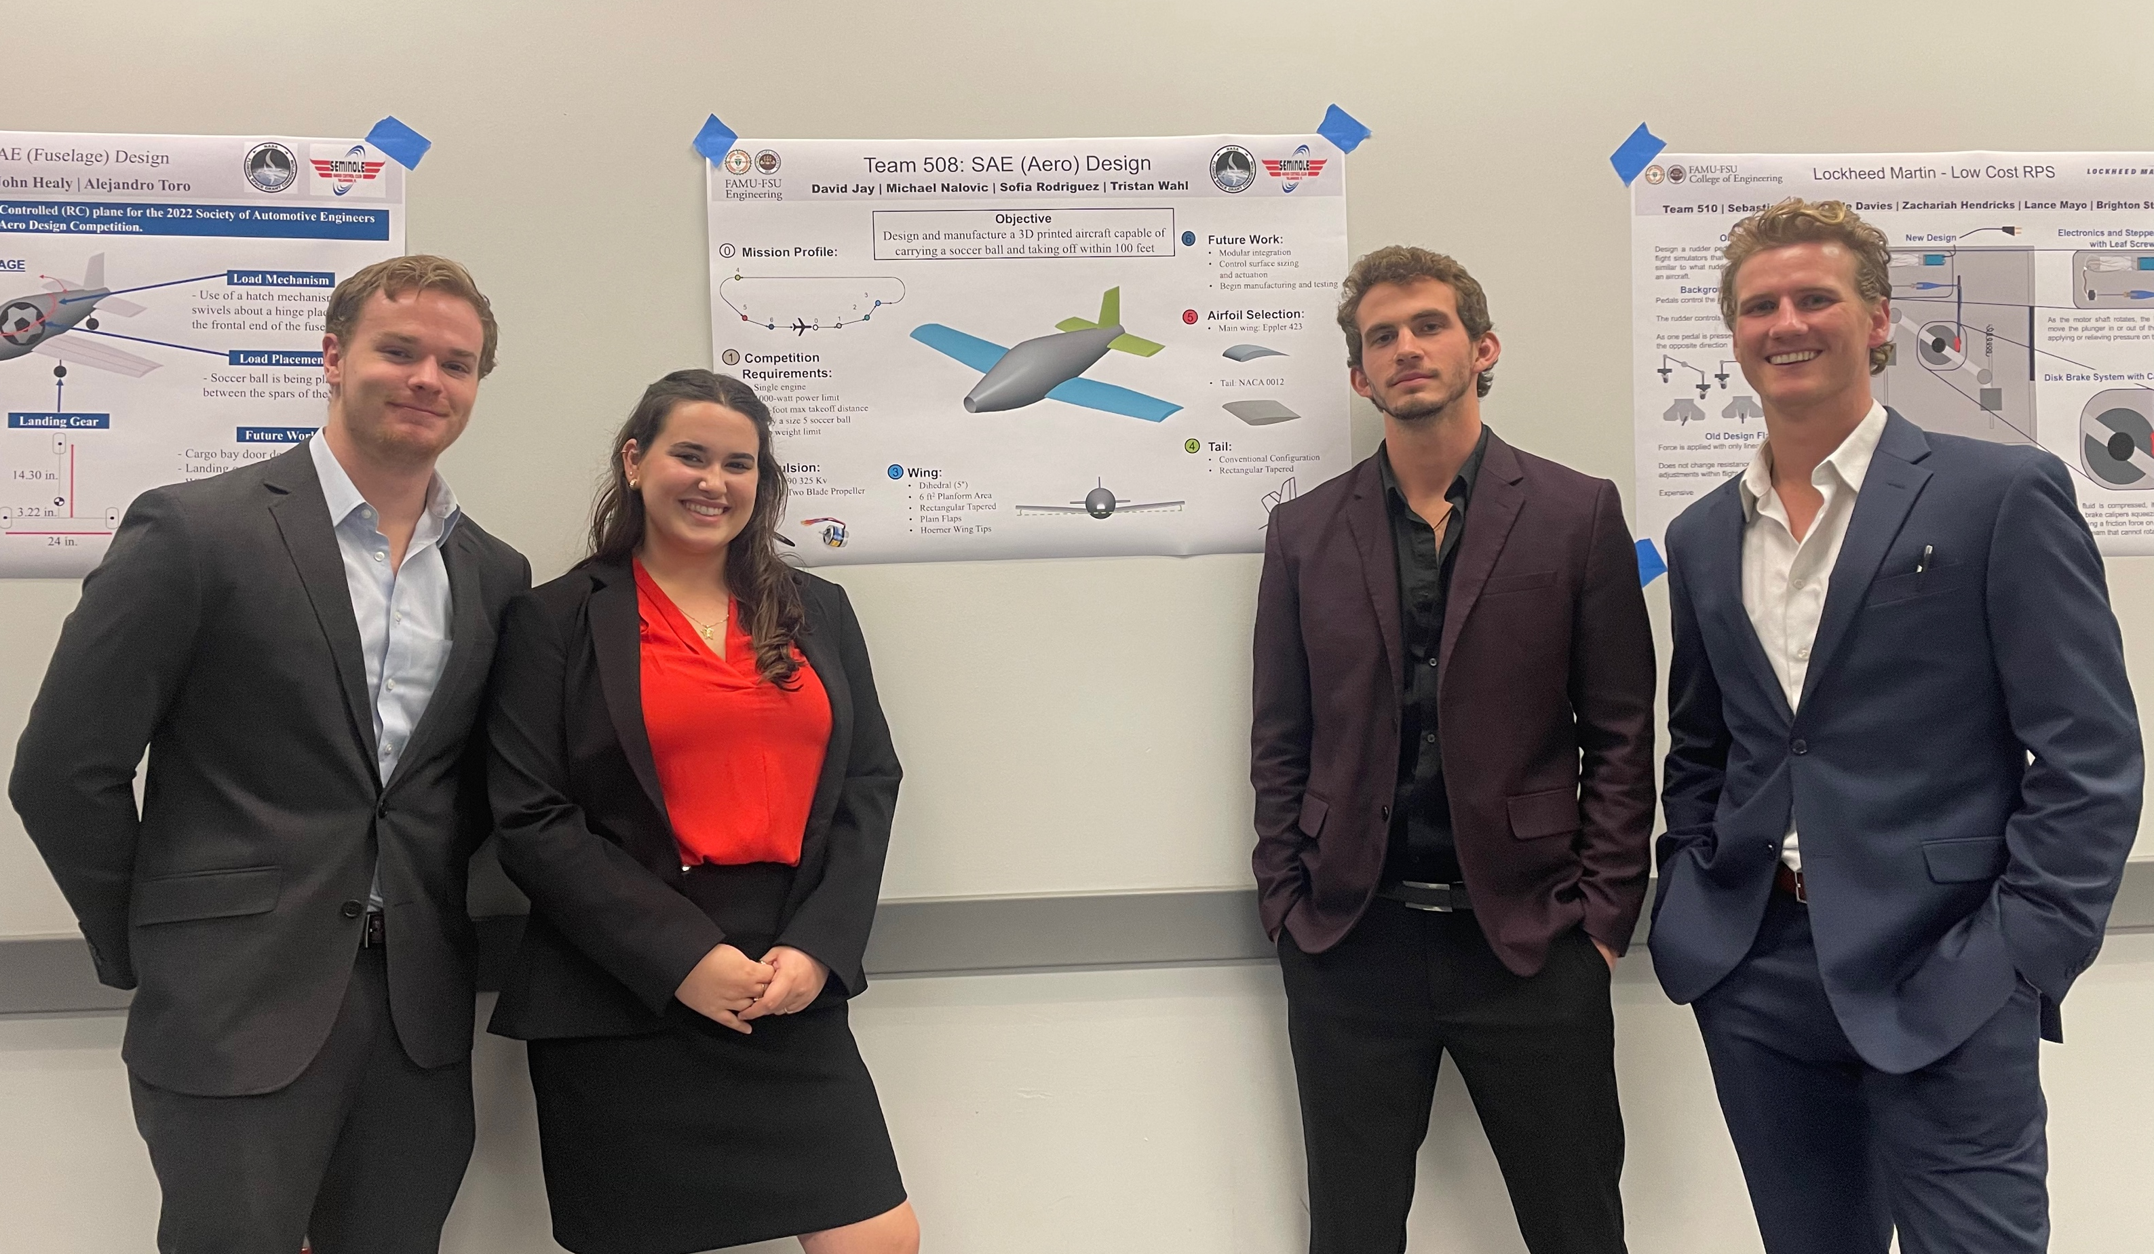
Project Website
TEAM 508
David Jay
dmj17b@my.fsu.edu
Sofia Rodriguez
smr16n@my.fsu.edu
Michael Nalovic
msn15@my.fsu.edu
Tristan Wahl
trw17c@my.fsu.edu

Slide 56
Static Margin
Neutral point behind the CG, static margin is positive
Ideal, would be %
Blank Blank
Notes:
Change the view to be side vide no tilt
Tilt one way

Slide 57
Static Margin
Neutral point forward of the CG, static margin is negative
How is it determined
Ideal, would be %
Blank Blank
Notes:
Change the view to be side vide no tilt
Tilt one way

Slide 58
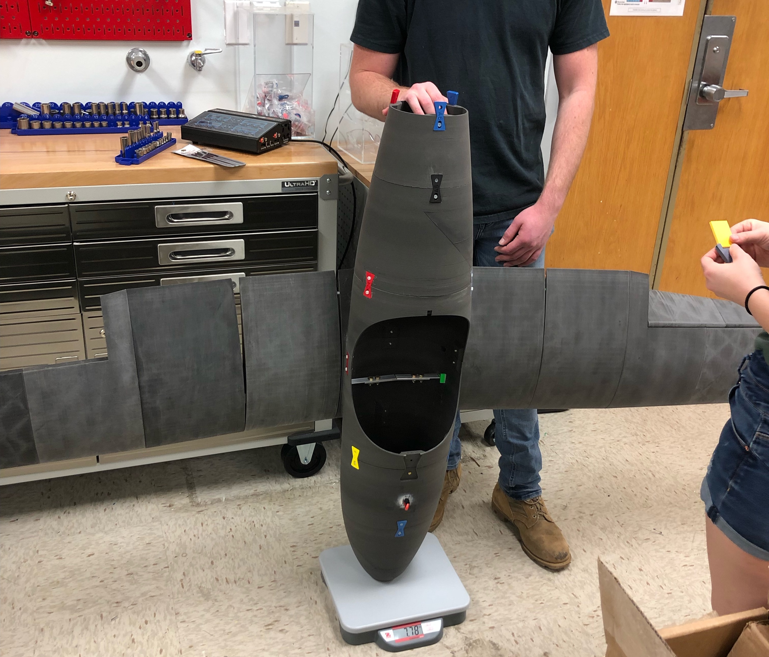
Determining CG
Photoshop me later
David Jay
Notes:
Put graphics

Slide 59
TEAM 508 COLORS
Accent1
647 C
Color Values:
RGB 35 97 146
Hex/HTML #236192
CMYK 96 54 5 27
Accent4
2239 C
Color Values:
RGB 0 207 180
Hex/HTML #00CFB4
CMYK 59 0 39 0
Light 1
White
Color Values:
RGB 255 255 255
Hex/HTML #FFFFFF
CMYK 0 0 0 0
Dark 1
100% Black
Color Values:
RGB 0 0 0
Hex/HTML #000000
CMYK 0 0 0 100
Pantone
647 C
Pantone
2239 C
White
Black
Accent 2
2199 C
Color Values:
RGB 0 187 220
Hex/HTML #00BBDC
CMYK 77 0 16 0
Accent5
7535 C
Color Values:
RGB 183 176 156
Hex/HTML #B7B09C
CMYK 10 11 23 19
Light 2
25% Black
Color Values:
RGB 191 191 191
Hex/HTML #bfbfbf
CMYK 0 0 0 25
Dark 2
75 % Black
Color Values:
RGB 64 64 64
Hex/HTML #404040
CMYK 0 0 0 75
Pantone
2199 C
Pantone
7535 C
CoE Lt Gray
CoE Dk Gray
Accent3
1788 C
Color Values:
RGB 238 39 55
Hex/HTML #EE2737
CMYK 0 88 82 0
Accent6
2299 C
Color Values:
RGB 164 210 51
Hex/HTML #A4D233
CMYK 41 0 84 0
Pantone
1788 C
Pantone
2299 C
Notes:
These are the college colors as prioritized within this PowerPoint Template

Slide 60
Horizontal Tail
Elevator will increase by 5" to account for fuselage connection
Elevator will be held by 2" aluminum pins and actuated by servo on underside of airfoil
20° of actuation in both directions
Figure 5: Horizontal Tail Assembly
Tristan Wahl

Slide 61
SERVO

Slide 62
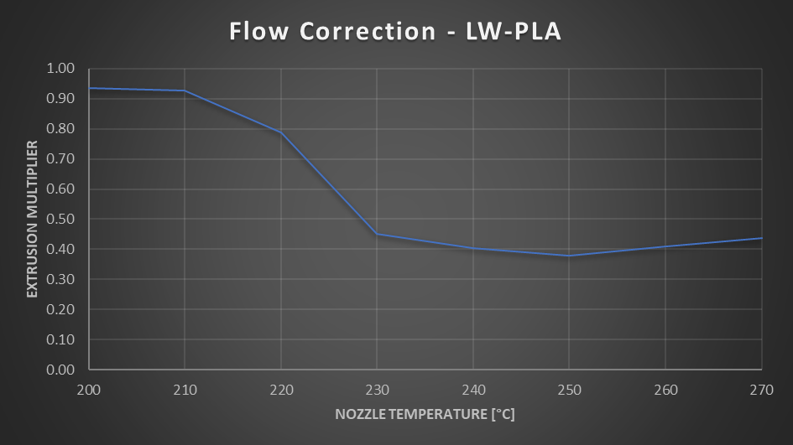
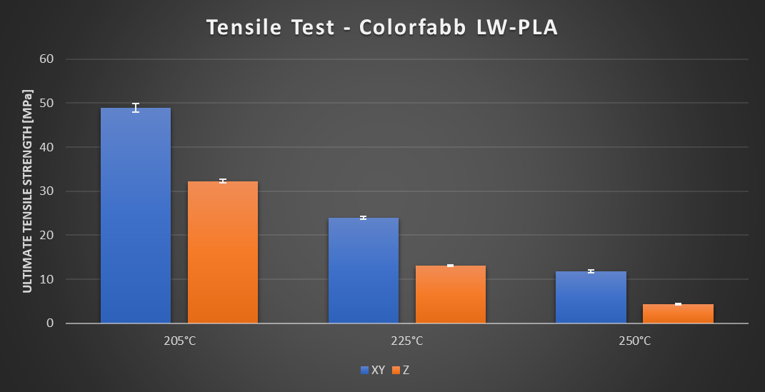
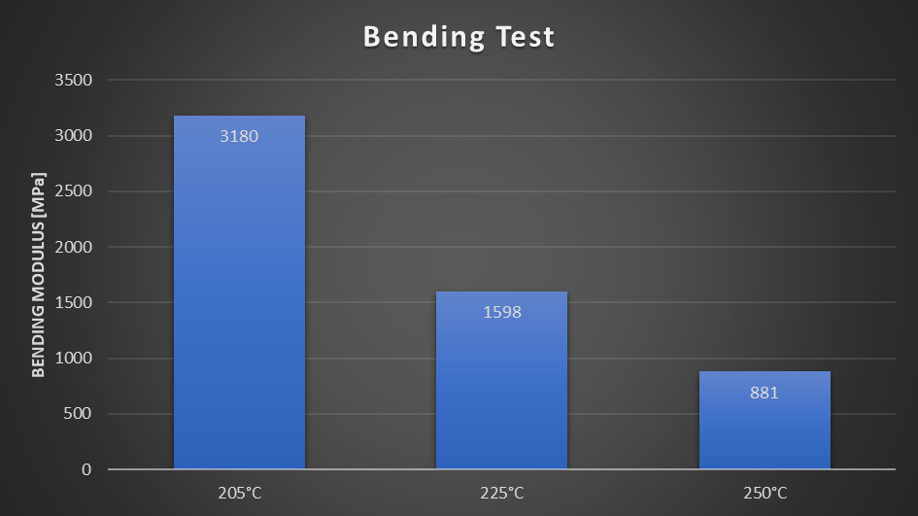
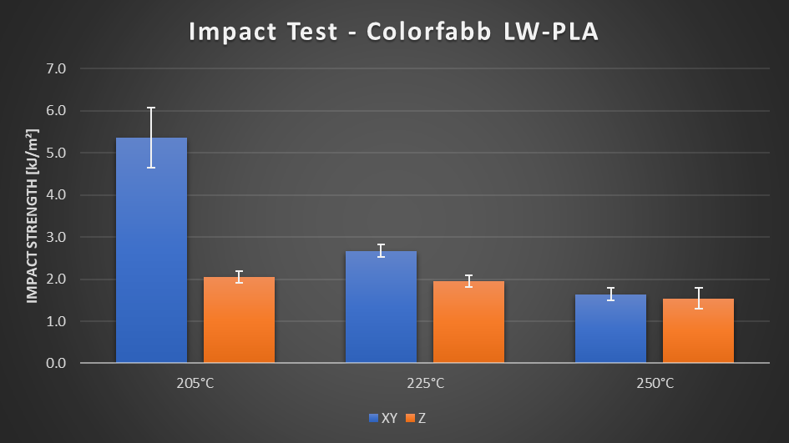
LWPLA more info
Notes:
CNC kitchen data

Slide 63
Tolerance Testing Data

Slide 64
$${\text{ρ}}_{Initial}=2.1\frac{g}{{cm}^{3}}$$
$${\text{ρ}}_{Shell}=flowrate∗{\text{ρ}}_{Initial}$$
$${\text{V}}_{Shell}=SA∗thickness$$
$${\text{ρ}}_{infill}=infill\%∗{\text{ρ}}_{Shell}$$
$$V_{infill}=V−V_{shell}$$

Slide 65
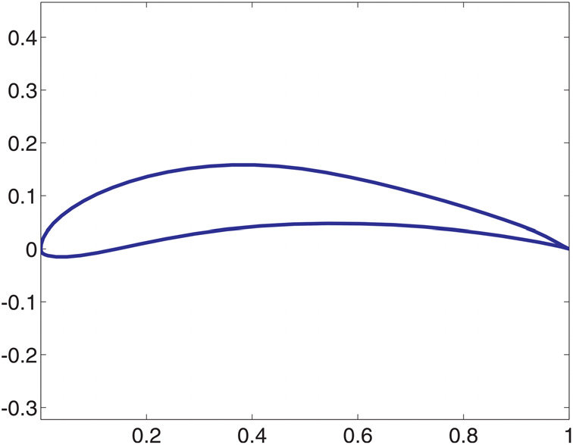
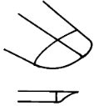
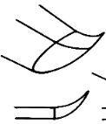
Concept Generation
Fuselage Type
Airfoil
Wing Placement
Landing Gear
Tail
Wing Tips
"Guppy"
High Wing
Standard
Cutoff
E-423
Tricycle
"Dolphin"
Mid Wing
T-Tail
Hoerner
S-1223
Tail Dragger
Low Wing
V-Tail
Upswept
"Whale"
Tristan Wahl
Notes:
In order to come up with multiple concept ideas, we started with a morphological chart with our initial design ideas.
We decided the 3 fuselage concepts from our prototypes, the airfoils from their data and earlier research, the wing placements and their various tradeoffs, the 2 landing gear setups, types of tails and eventually wingtips to help with our innovation requirement
http://www.zenithair.com/stolch801/design/design.html

Slide 66
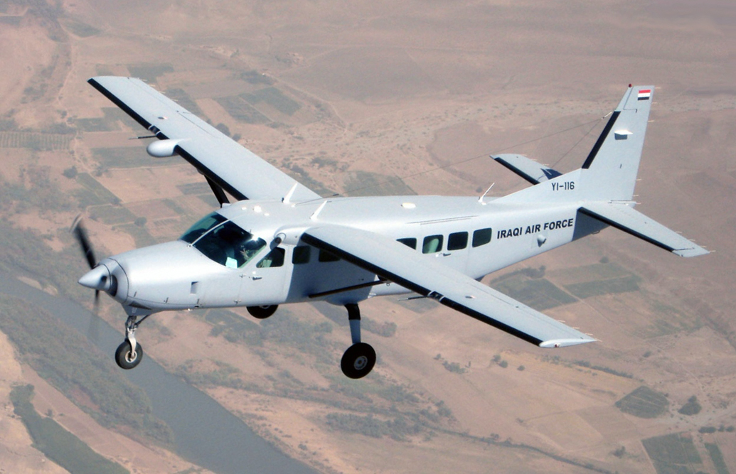
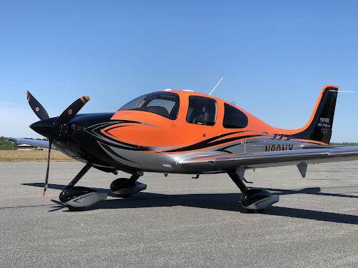
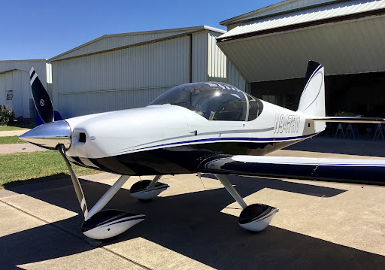
Medium Fidelity Concepts
Concept 1
Air Tractor AT-502B
Concept 2
Cessna 208B
Concept 3
Cirrus SR-22
Concept 4
Vans Aircraft RV-14
Fig.1 Air Tractor
Fig. 2 Cessna 208B
Fig. 3 Cirrus SR-22
Fig. 4 Vans Aircraft RV-14
Tristan Wahl
Notes:
Talking Points: Wing Placement, Fuselage design, Landing Gear Configuration. They all meet certain criteria of our morphological chart and would be easier to scale down a version than to create an altogether original design. We list them as medium fidelity concepts because scaling down an existing design is not very innovative
Reference: https://www.texascooppower.com/texas-stories/life-arts/the-building-of-a-bird
https://en.wikipedia.org/wiki/Cessna_208_Caravan

Slide 67
Concept Selection
Customer Needs
Comply with SAE guidelines
Engineering Characteristics
Weight
Control Surface Deflection
Static Margin
Thrust Force
Resistance to stress
Innovate
3D Printed
Customer needs were broken down into engineering characteristics
Importance weight factor calculated for each engineering characteristic to determine which are most vital to success
David Jay
Notes:
Most of our engineering characteristics come from the SAE competition guidelines. 5 of the most important engineering characteristics are listed here.
We want to:
-Decrease Weight
-Constrain control surface deflection
-Constrain static margin
-Increase Thrust force
-Increase resistance to stress (make sure the plane doesn’t break under loading)

Slide 68
Concept Selection
Alternative Values Calculated from Selection Process
0.524
Cirrus SR-22
0.476
Vans Aircraft RV-14
David Jay
Notes:
After going through multiple iterations of the concept selection process, we narrowed it down to two candidates. In the end, the Cirrus SR-22 won by a small margin against the Vans RV-14. Both concepts are extremely similar, which makes sense why they are so close in selection values.
One thing to note is that concept selection for an entire airplane is not a trivial task. Almost every decision affects the aerodynamics of the plane and there are thousands of decisions that could be made. Our team used this concept selection process to decide on a final layout of the plane rather than specific details. In addition, nothing scales perfectly, so it’s very likely that our final design differs as we iterate and reanalyze.
If we were to do this project again, we may consider doing a concept selection process for each aspect of the plane, rather than the entire design.

Slide 69
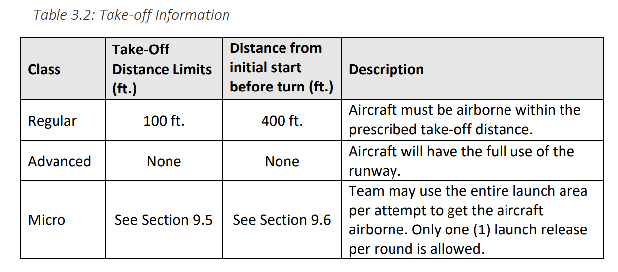
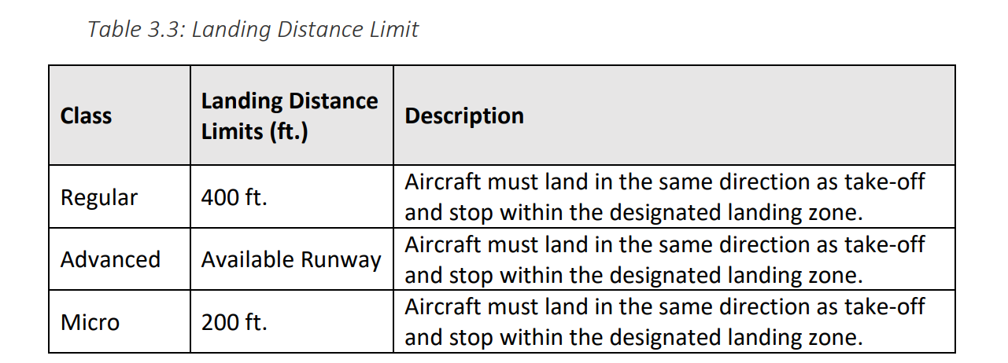
SAE Guidelines

Slide 70
Lift/Velocity Estimations
Thrust Force (Ft)
Drag Force $(Fd=\frac{1}{2}C_{D}ρv^{2}A)$
$$x$$
$$v$$
Equations of Motion:
$m\ddot{x}=Ft − \frac{1}{2}C_{D,w}ρ{\dot{x}}^{2}A_{w}$ $− \frac{1}{2}C_{D,f}ρ{\dot{x}}^{2}A_{f}$

